Slide 1

Lesson-13
李老师& 开课吧人工智能学院课程组
20120.04

Slide 2
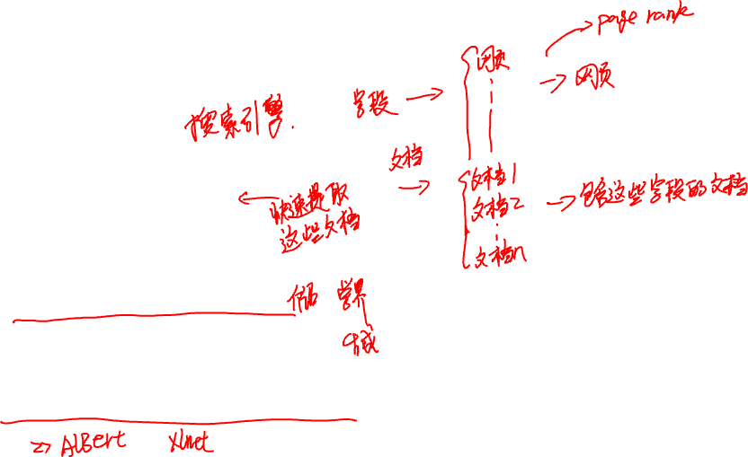
Overview
Search engine
Background
Keywords search
Boolean search
Dialogue system (STOA)
GPT2 review
GPT2 based dialog system
Implementation details

Slide 3
Search engine

Slide 4
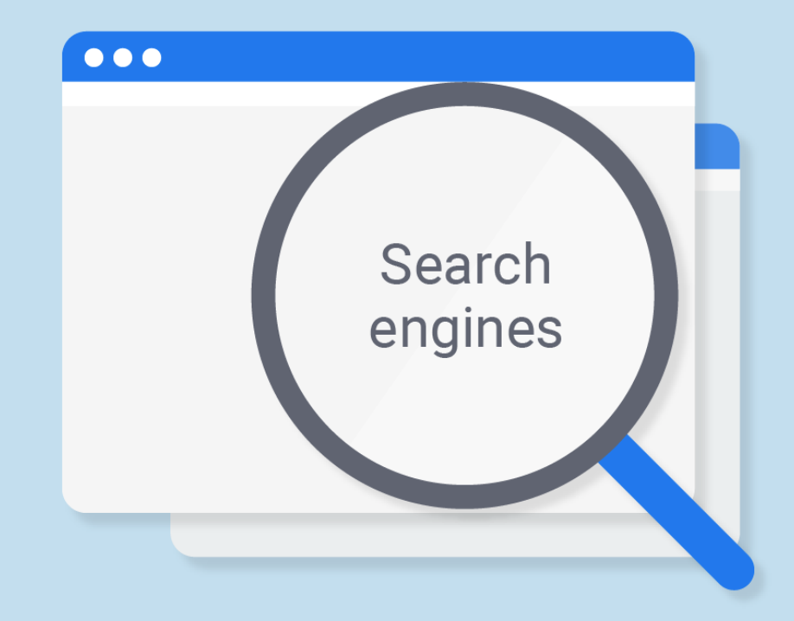
Background
Key words : artificial intelligence, nlp
Target: Find related documents
Related documents are those documents that contain those key words.

Slide 5

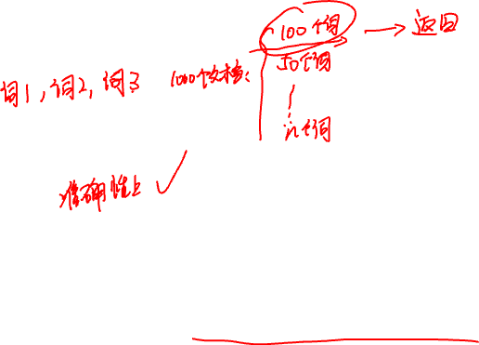
Key words search ( a naïve way)
1 . Use keywords to represent document.
2. Brute force (search all words in all documents)
Problem: very very time consuming !!!!

Slide 6
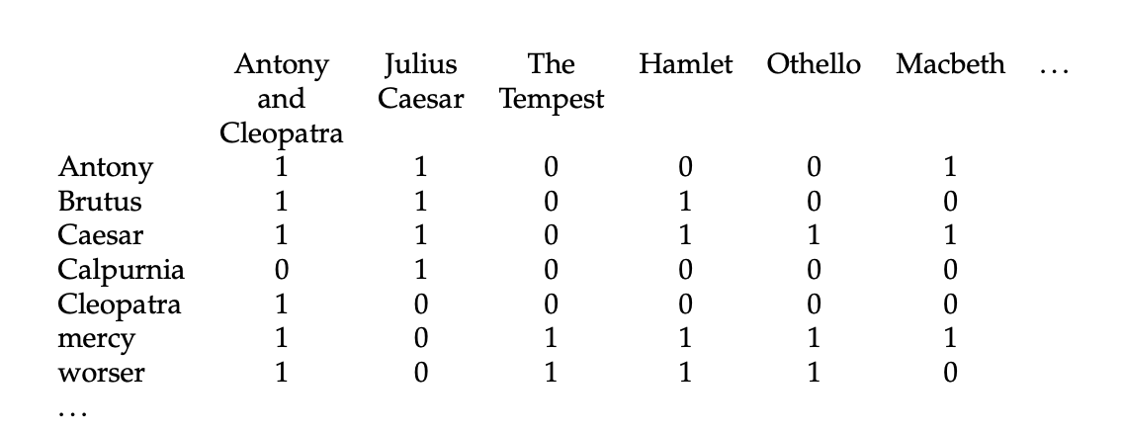




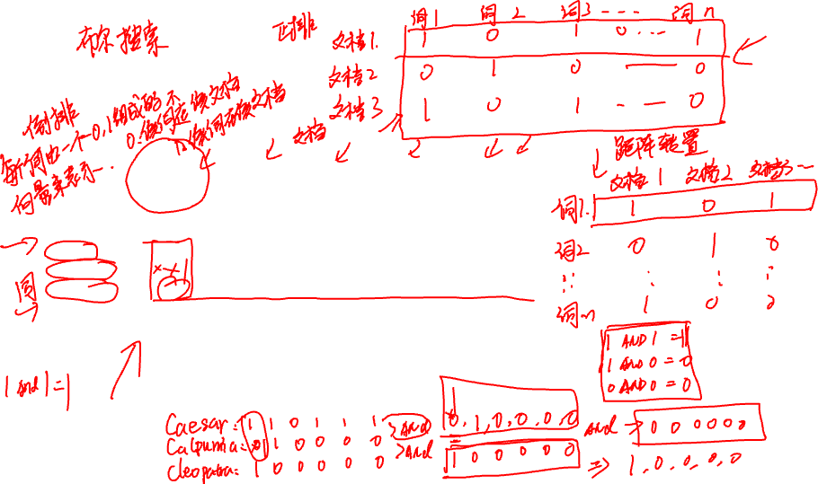
Boolean search

Slide 7


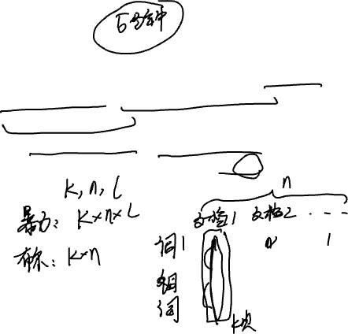
Test your understanding
1. What is the approximate time complexity of brute force search and boolean search? (Assume that there are k key words, n documents, and the average document length is l. )

Slide 8

An example

Slide 9

Dialogue system (GPT2)

Slide 10
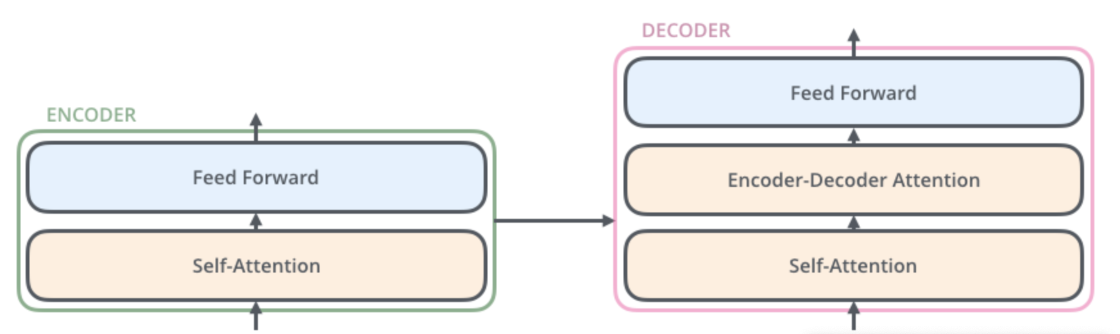
A review of GPT2 Model （transformer)

Slide 11
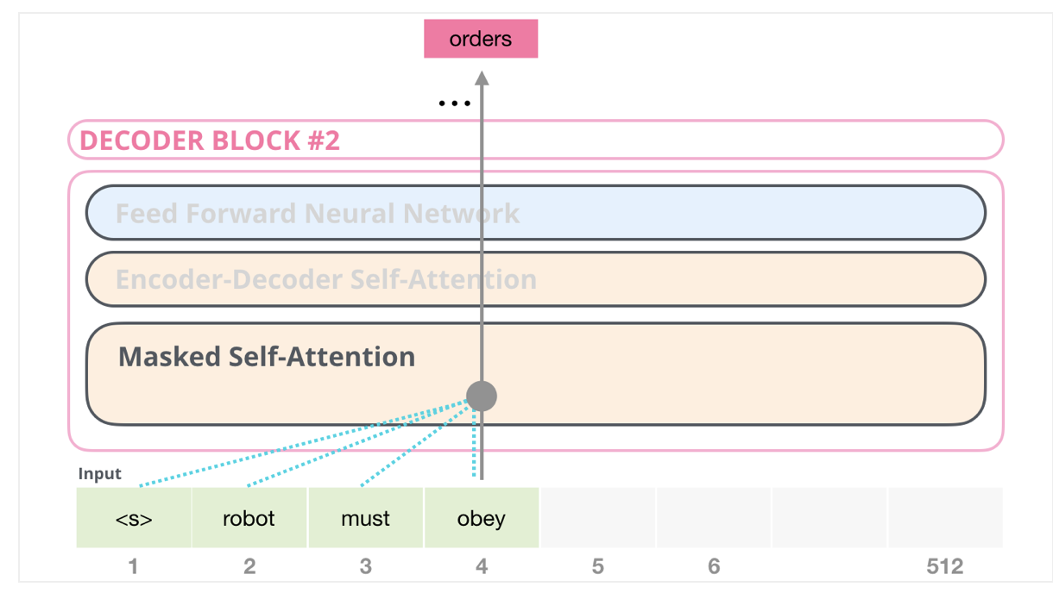
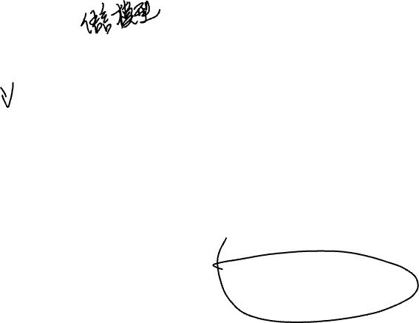
GPT2

Slide 12
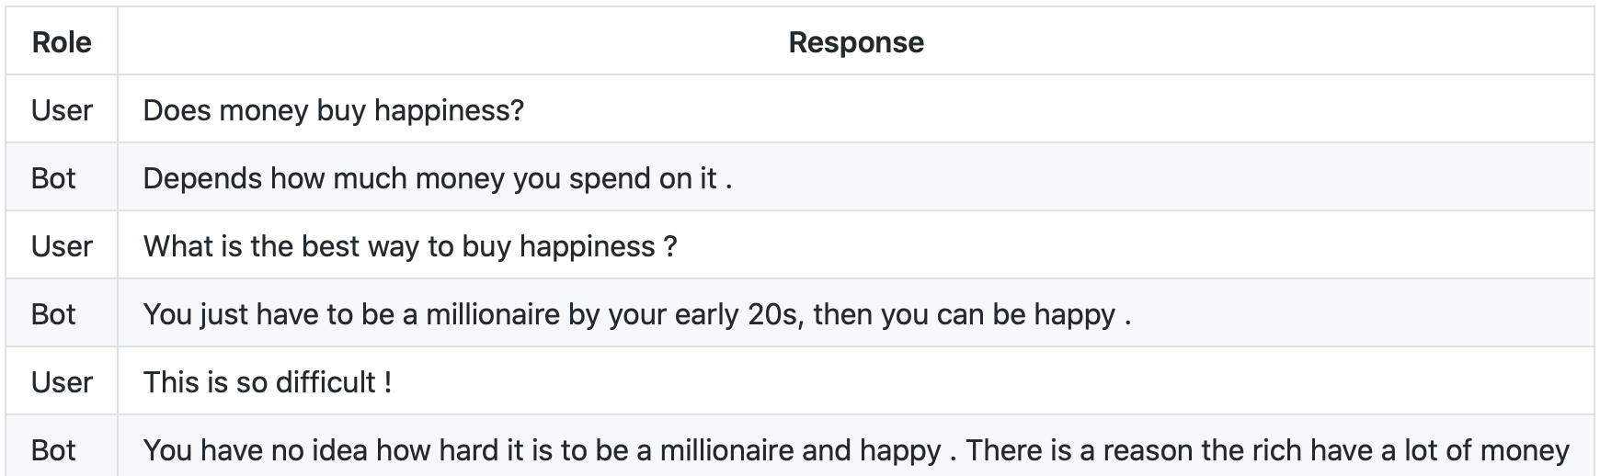

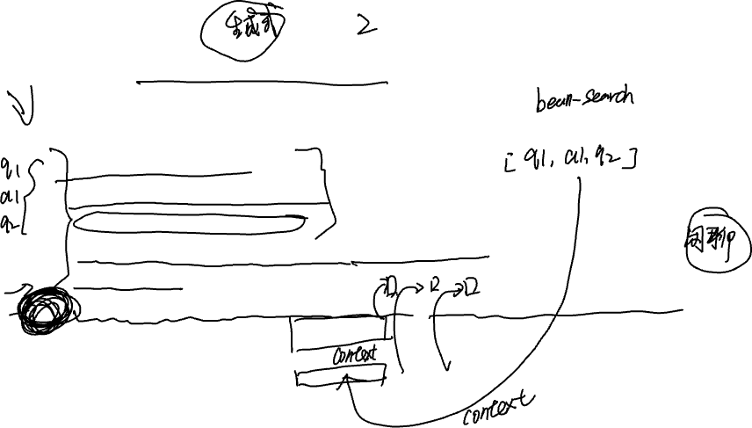
See the dialogue system as language model

Slide 13
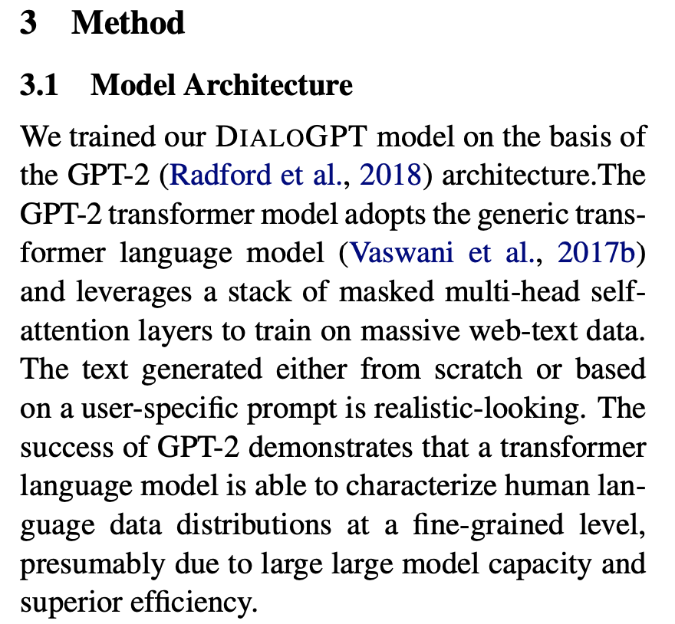
Model description

Slide 14
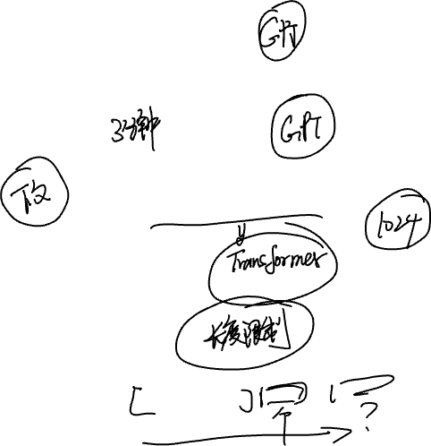
Test your understanding
What are the disadvantages of this model ?

Slide 16
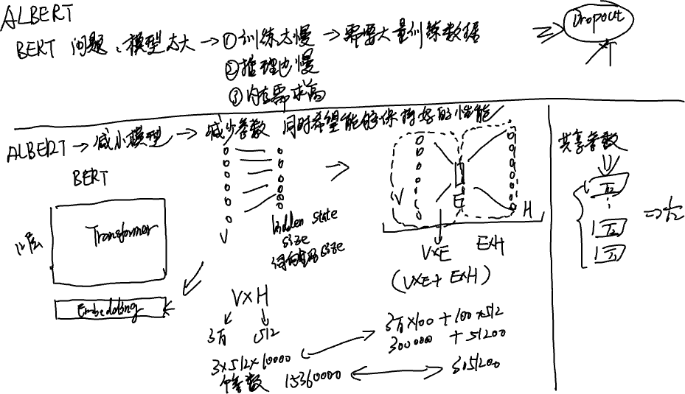
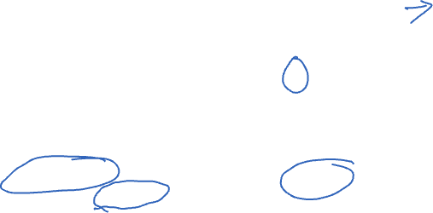

Slide 17

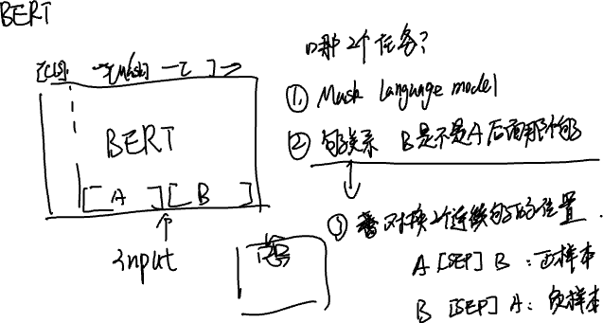


Slide 18
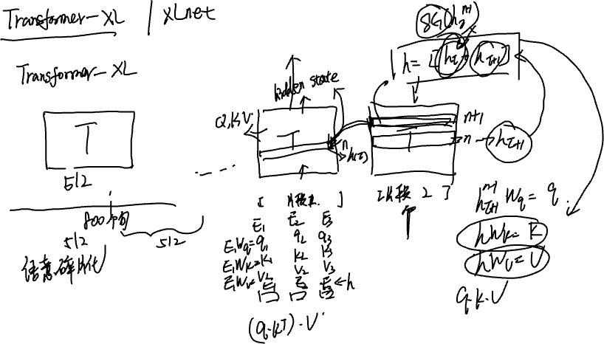

Slide 19



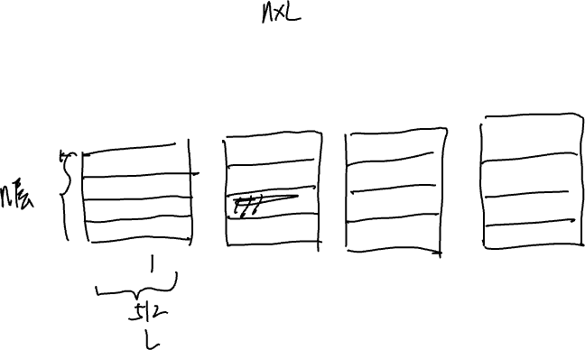



Slide 20
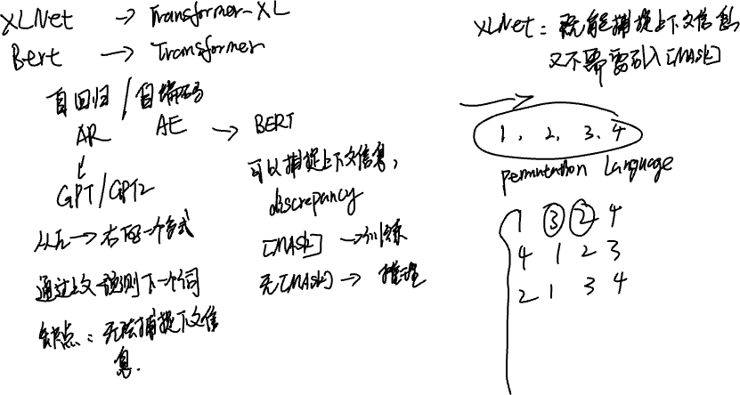

Slide 21

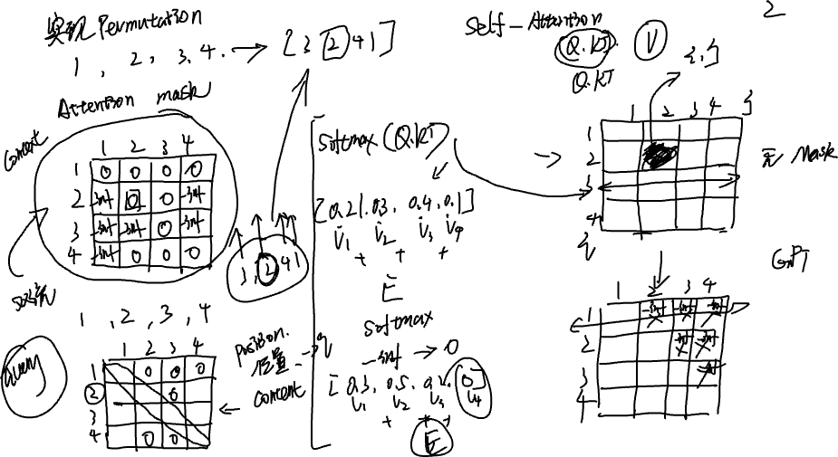


Slide 22
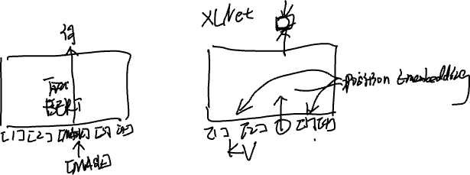

Slide 23
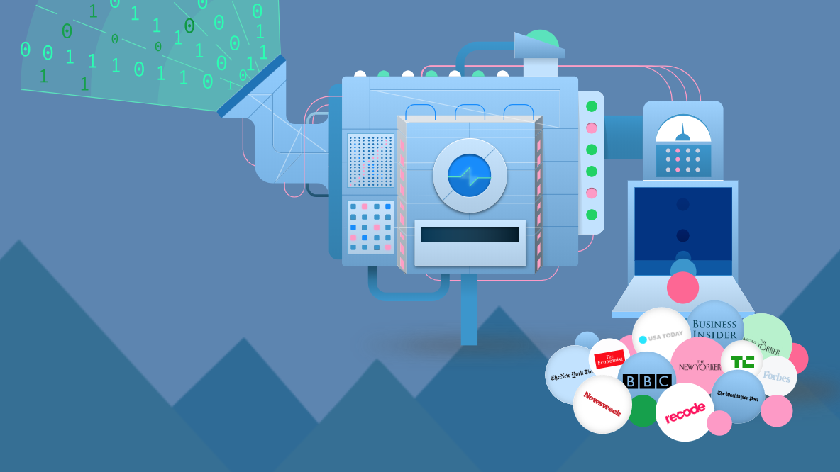
Thanks for your attention!

